Slide 1
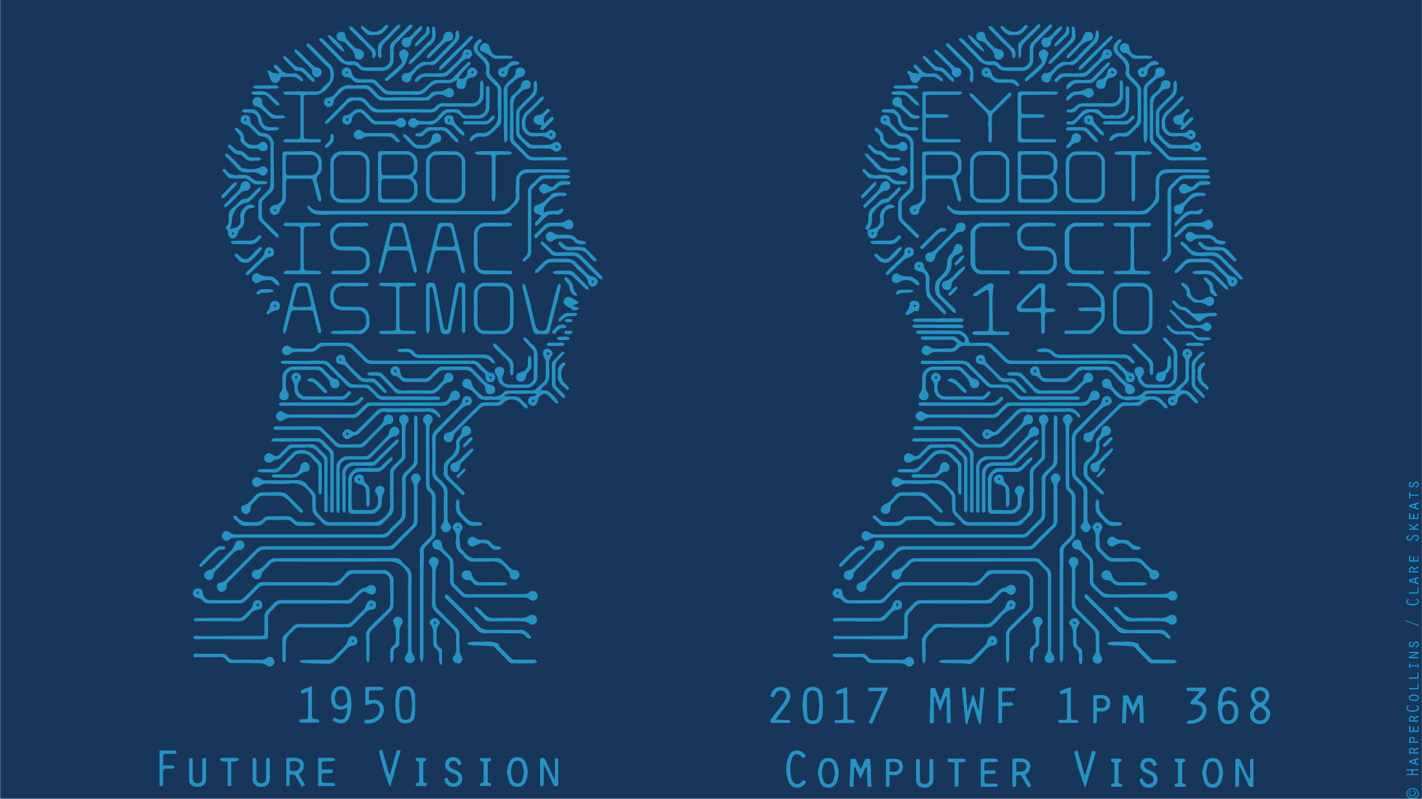
Notes:
Hello everyone, welcome to the course on 20th century science fiction literature.
Note: If you see a little ‘JH’ in the corner of the slides, then it means it was taken piecemeal from James Hays’ old class. Thank you to him and his course staff, over many years.

Slide 2
Notes:
Oh, no, wait, sorry, I meant, welcome to the implementation of 20th-century science fiction literature, or a small part of it, where we will learn about computer or machine or robot vision.

Slide 3
Have you ever used computer vision?
How? Where?
Think-Pair-Share
Notes:
So, to begin, let’s conduct a little exercise. In the broadest sense, have you ever used computer vision? How? Where?
We’ll run a little ‘think-pair-share’ – for those of you unfamiliar, we think individually about the problem for a minute, then we will pair with a partner sitting next to you in the room to discuss it for another minute, then we will share our thoughts in the class.
Now, to help frame your thoughts, I’m going to introduce an idea.

Slide 4

Jitendra Malik, UC Berkeley
Three ‘R’s of Computer Vision
Notes:
Jitendra Malik – pioneer of computer vision (?)
Tried to coin a ‘Three R’s’ for computer vision. Instead of ‘reading, writing, and arithmetic’….
“For example, in the recent PASCAL benchmark challenge on visual object detection, the average precision for most 3D object categories was under 50%.”

Slide 5
Jitendra Malik, UC Berkeley
Three ‘R’s of Computer Vision
“The classic problems of computational vision:
reconstruction
recognition
(re)organization.”
Notes:
Jitendra Malik – pioneer of computer vision (?)
Tried to coin a ‘Three R’s’ for computer vision. Instead of ‘reading, writing, and arithmetic’….
“For example, in the recent PASCAL benchmark challenge on visual object detection, the average precision for most 3D object categories was under 50%.”

Slide 6
Have you ever used computer vision?
How? Where?
Reconstruction? Recognition? (Re)organization?
Think-Pair-Share
Notes:
So, let’s think about this question individually for a minute.
Now, in pairs, and that means potentially turning around in your seat, greet your neighbor, and please discuss your thoughts.
Board exercise: canvass the room. Write everything on the board that they come up with; put it into three R categories (many are in multiple).
Call up help from a TA to write on the board.

Slide 7
Laptop: Biometrics auto-login (face recognition, 3D), OCR
Smartphones: QR codes, computational photography (Android Lens Blur, iPhone Portrait Mode), panorama construction (Google Photo Spheres), face detection, expression detection (smile), Snapchat filters (face tracking), Google Tango (3D reconstruction),
Web: Image search, Google photos (face recognition, object recognition, scene recognition, geolocalization from vision), Facebook (image captioning), Google maps aerial imaging (image stitching), YouTube (content categorization)
VR/AR: outside-in tracking (HTC VIVE), inside out tracking (simultaneous localization and mapping, HoloLens)
Xbox: Kinect, full body tracking of skeleton, gesture recognition
Medical imaging: CAT / MRI reconstruction, assisted diagnosis, automatic pathology, connectomics, endoscopic surgery
Industry: vision-based robotics (marker-based), machine-assisted router (jig), automated post, ANPR (number plates), surveillance, drones
Transportation: assisted driving (everything), face tracking/iris dilation for drunkeness, drowsiness
Media: Visual effects for film, TV (reconstruction), virtual sports replay (reconstruction), semantics-based auto edits (reconstruction, recognition)
Notes:
James made a 10-minute list of all the existing applications that he could think of which used computer vision.

Slide 8
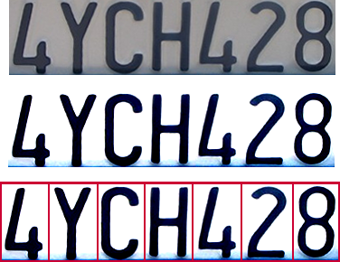

Optical character recognition (OCR)
Technology to convert scanned docs to text
If you have a scanner, it probably came with OCR software
Digit recognition, AT&T labs
http://www.research.att.com/~yann/
License plate readers
http://en.wikipedia.org/wiki/Automatic_number_plate_recognition
JH
Notes:
If you see a little ‘JH’ in the corner of the slides, then it means it was taken piecemeal from James Hays’ old class. Thank you to him and his course staff, over many years.

Slide 9
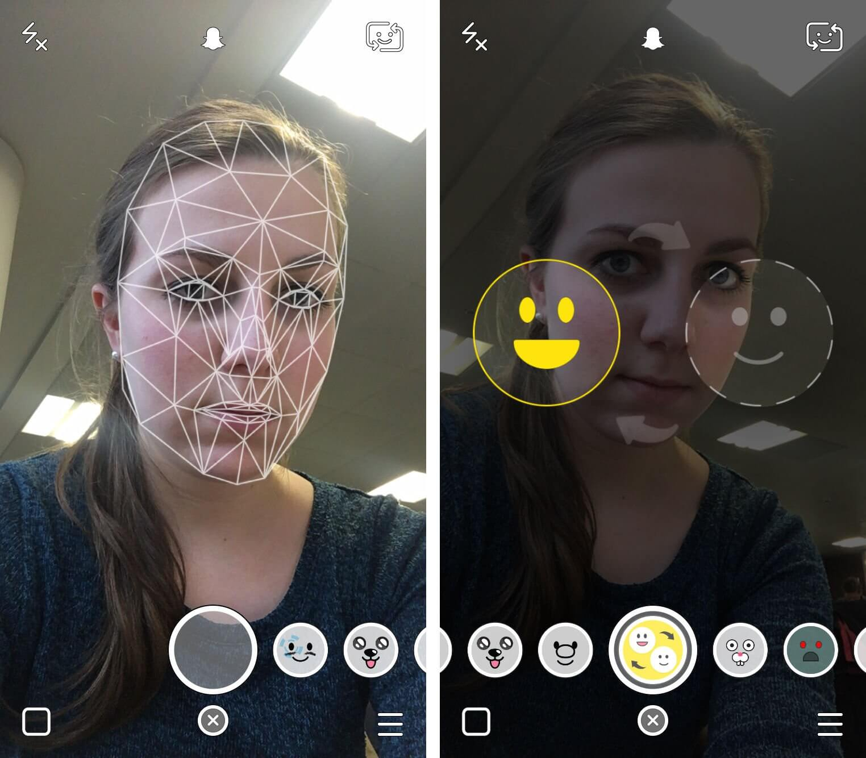
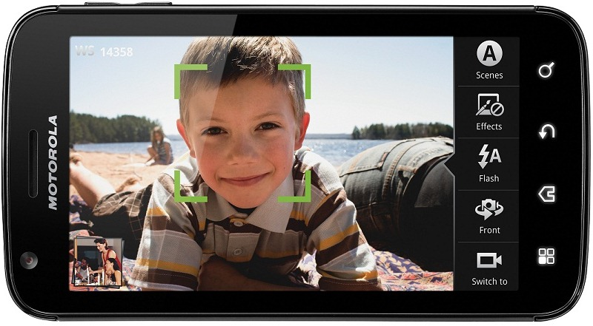
Face detection
Almost all digital cameras detect faces
Snapchat face filters
Notes:
https://www.google.com/url?sa=i&rct=j&q=&esrc=s&source=images&cd=&cad=rja&uact=8&ved=0ahUKEwjPu6nd1N3RAhVK7iYKHWSoDyAQjRwIBw&url=http%3A%2F%2Fforum.xda-developers.com%2Fshowthread.php%3Ft%3D1469709&bvm=bv.145063293,d.eWE&psig=AFQjCNEE8xqcq-R_KwPK2wc0Myo9pkI5Sg&ust=1485446226449425
Why would this be useful? Main reason is focus. Also enables “smart” cropping.

Slide 10

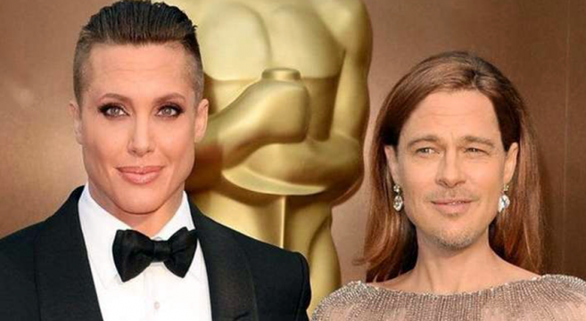
Notes:
Snapchat
Photo - http://thetechjournal.com/how-to/tutorial-face-swap-snapchat.xhtml
http://www.pleated-jeans.com/2016/03/02/21-snapchat-face-swaps-that-went-horribly-wrong/

Slide 11


Notes:
Image - http://www.pleated-jeans.com/2016/03/02/21-snapchat-face-swaps-that-went-horribly-wrong/
What went wrong here?

Slide 12
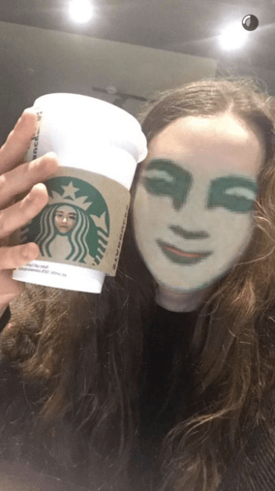
Notes:
Image - http://www.pleated-jeans.com/2016/03/02/21-snapchat-face-swaps-that-went-horribly-wrong/
What went wrong here?

Slide 13
Smile detection
Sony Cyber-shot® T70 Digital Still Camera
JH

Slide 14
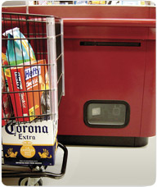
Object recognition (in supermarkets)
LaneHawk by EvolutionRobotics
“A smart camera is flush-mounted in the checkout lane, continuously watching for items. When an item is detected and recognized, the cashier verifies the quantity of items that were found under the basket, and continues to close the transaction. The item can remain under the basket, and with LaneHawk,you are assured to get paid for it… “
JH

Slide 15
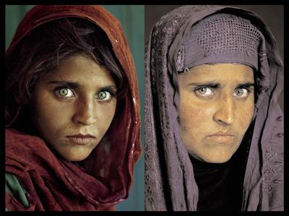
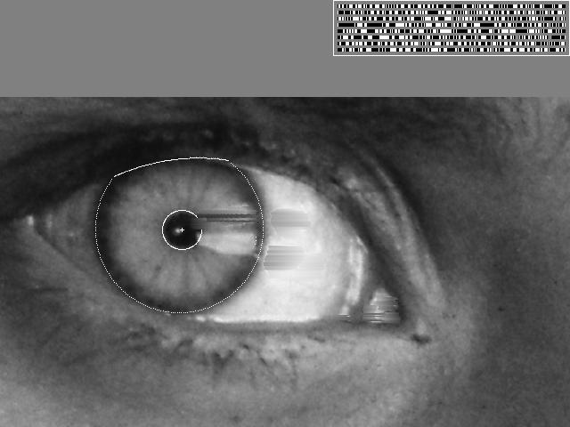
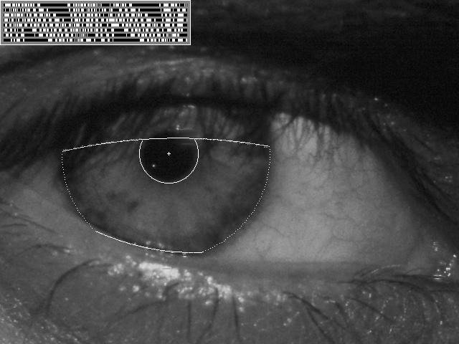
Vision-based biometrics
“How the Afghan Girl was Identified by Her Iris Patterns” Read the story
wikipedia
JH
Notes:
Age 12, Age 30

Slide 16
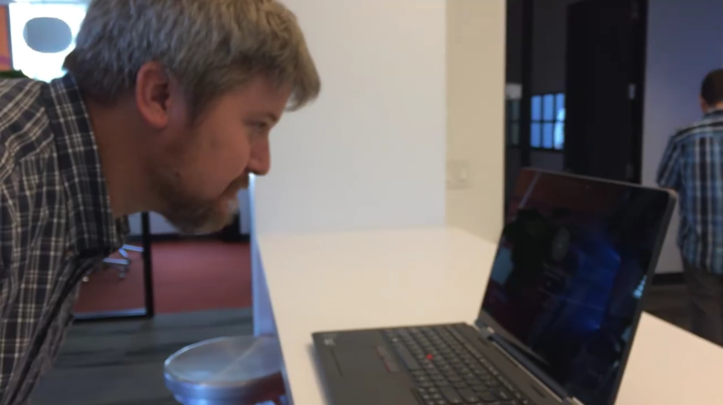
Login without a password…
Notes:
https://www.google.com/url?sa=i&rct=j&q=&esrc=s&source=images&cd=&cad=rja&uact=8&ved=0ahUKEwiJmrLm1d3RAhUJ4yYKHYhOBHkQjRwIBw&url=http%3A%2F%2Fwww.pcworld.com%2Farticle%2F2953512%2Fwindows%2Fhands-on-with-windows-10s-windows-hello-it-just-works.html&bvm=bv.145063293,d.eWE&psig=AFQjCNHypmDl0y-viWICMOJODxtwmz34Bg&ust=1485446513829330
https://www.google.com/url?sa=i&rct=j&q=&esrc=s&source=images&cd=&cad=rja&uact=8&ved=0ahUKEwiDkbnw1d3RAhUB3iYKHXs3DnsQjRwIBw&url=http%3A%2F%2Fwww.pcworld.com%2Farticle%2F2937701%2Fwhy-most-of-us-will-miss-out-on-windows-hello-windows-10s-facial-recognition-feature.html&bvm=bv.145063293,d.eWE&psig=AFQjCNHypmDl0y-viWICMOJODxtwmz34Bg&ust=1485446513829330
https://www.google.com/url?sa=i&rct=j&q=&esrc=s&source=images&cd=&cad=rja&uact=8&ved=0ahUKEwjD0LuA1t3RAhUKRSYKHVTSAgwQjRwIBw&url=http%3A%2F%2Fwww.directtechnologygroup.com%2Fblog%2Fentry%2Ftip-of-the-week-windows-hello-unlocks-your-pc-with-your-face&bvm=bv.145063293,d.eWE&psig=AFQjCNHypmDl0y-viWICMOJODxtwmz34Bg&ust=1485446513829330

Slide 17
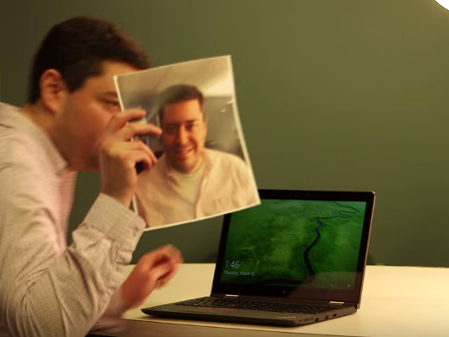
Login without a password…
Notes:
https://www.google.com/url?sa=i&rct=j&q=&esrc=s&source=images&cd=&cad=rja&uact=8&ved=0ahUKEwiJmrLm1d3RAhUJ4yYKHYhOBHkQjRwIBw&url=http%3A%2F%2Fwww.pcworld.com%2Farticle%2F2953512%2Fwindows%2Fhands-on-with-windows-10s-windows-hello-it-just-works.html&bvm=bv.145063293,d.eWE&psig=AFQjCNHypmDl0y-viWICMOJODxtwmz34Bg&ust=1485446513829330
https://www.google.com/url?sa=i&rct=j&q=&esrc=s&source=images&cd=&cad=rja&uact=8&ved=0ahUKEwiDkbnw1d3RAhUB3iYKHXs3DnsQjRwIBw&url=http%3A%2F%2Fwww.pcworld.com%2Farticle%2F2937701%2Fwhy-most-of-us-will-miss-out-on-windows-hello-windows-10s-facial-recognition-feature.html&bvm=bv.145063293,d.eWE&psig=AFQjCNHypmDl0y-viWICMOJODxtwmz34Bg&ust=1485446513829330
https://www.google.com/url?sa=i&rct=j&q=&esrc=s&source=images&cd=&cad=rja&uact=8&ved=0ahUKEwjD0LuA1t3RAhUKRSYKHVTSAgwQjRwIBw&url=http%3A%2F%2Fwww.directtechnologygroup.com%2Fblog%2Fentry%2Ftip-of-the-week-windows-hello-unlocks-your-pc-with-your-face&bvm=bv.145063293,d.eWE&psig=AFQjCNHypmDl0y-viWICMOJODxtwmz34Bg&ust=1485446513829330

Slide 18
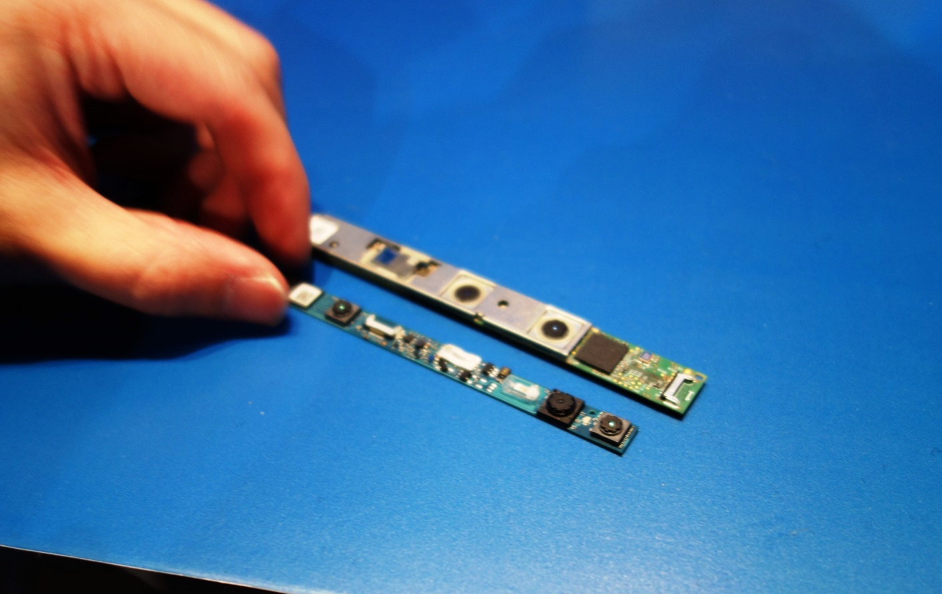
Login without a password…
Notes:
https://www.google.com/url?sa=i&rct=j&q=&esrc=s&source=images&cd=&cad=rja&uact=8&ved=0ahUKEwiJmrLm1d3RAhUJ4yYKHYhOBHkQjRwIBw&url=http%3A%2F%2Fwww.pcworld.com%2Farticle%2F2953512%2Fwindows%2Fhands-on-with-windows-10s-windows-hello-it-just-works.html&bvm=bv.145063293,d.eWE&psig=AFQjCNHypmDl0y-viWICMOJODxtwmz34Bg&ust=1485446513829330
https://www.google.com/url?sa=i&rct=j&q=&esrc=s&source=images&cd=&cad=rja&uact=8&ved=0ahUKEwiDkbnw1d3RAhUB3iYKHXs3DnsQjRwIBw&url=http%3A%2F%2Fwww.pcworld.com%2Farticle%2F2937701%2Fwhy-most-of-us-will-miss-out-on-windows-hello-windows-10s-facial-recognition-feature.html&bvm=bv.145063293,d.eWE&psig=AFQjCNHypmDl0y-viWICMOJODxtwmz34Bg&ust=1485446513829330
https://www.google.com/url?sa=i&rct=j&q=&esrc=s&source=images&cd=&cad=rja&uact=8&ved=0ahUKEwjD0LuA1t3RAhUKRSYKHVTSAgwQjRwIBw&url=http%3A%2F%2Fwww.directtechnologygroup.com%2Fblog%2Fentry%2Ftip-of-the-week-windows-hello-unlocks-your-pc-with-your-face&bvm=bv.145063293,d.eWE&psig=AFQjCNHypmDl0y-viWICMOJODxtwmz34Bg&ust=1485446513829330

Slide 19
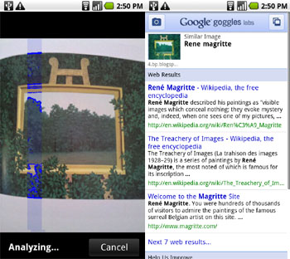
Object recognition (in mobile phones)
Google Goggles
Wikipedia: “In a May 2014 update to Google Mobile for iOS, the Google Goggles feature was removed due to being ‘of no clear use to too many people.’“ : (

Slide 20
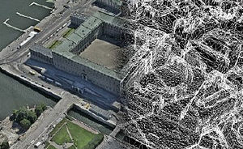
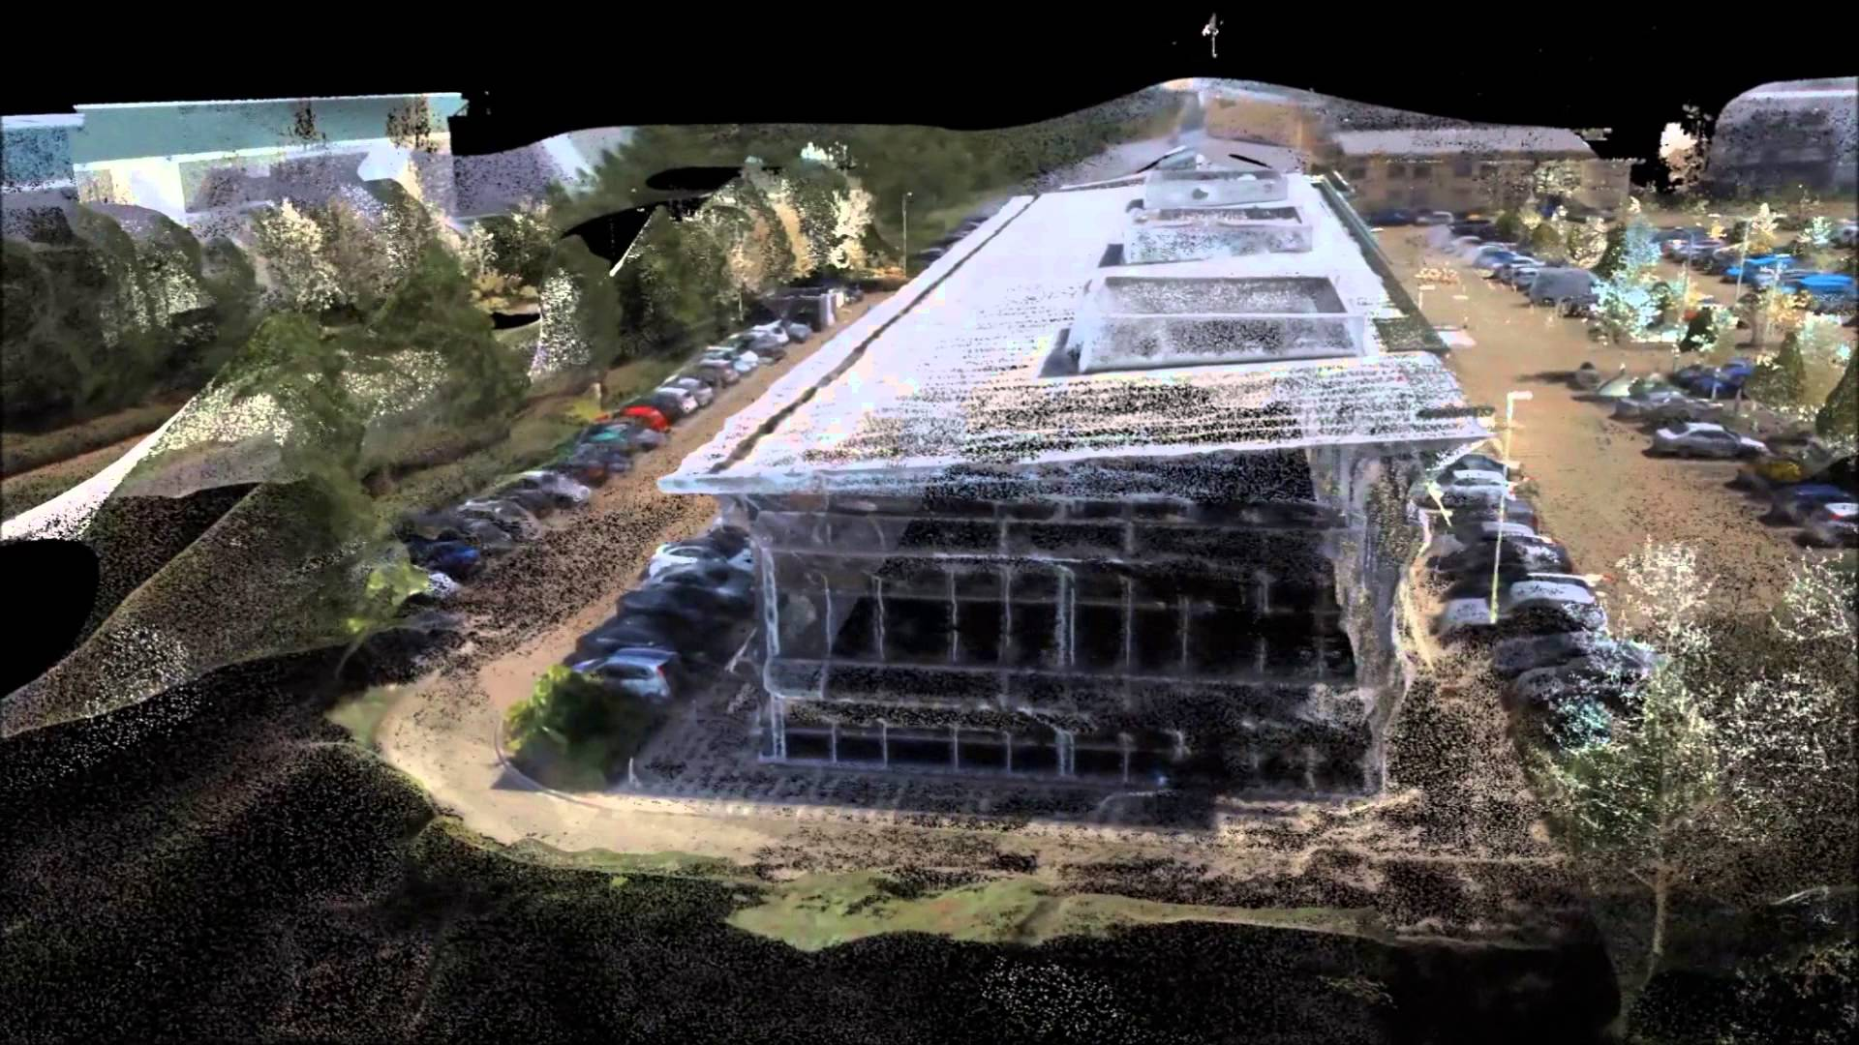
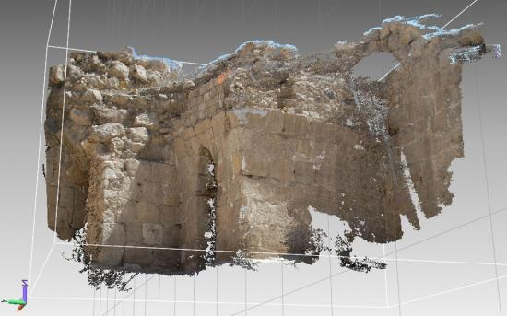
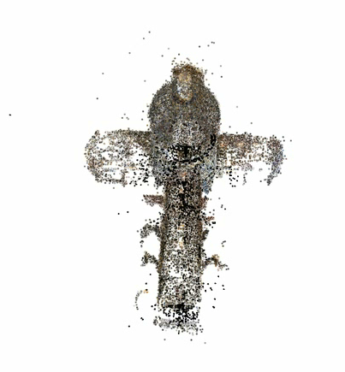
3D from images
Building Rome in a Day: Agarwal et al. 2009
Notes:
https://www.google.com/url?sa=i&rct=j&q=&esrc=s&source=images&cd=&cad=rja&uact=8&ved=0ahUKEwiO3azs1t3RAhVMSyYKHe67Bh8QjRwIBw&url=https%3A%2F%2Fen.wikipedia.org%2Fwiki%2FPhotogrammetry&bvm=bv.145063293,d.eWE&psig=AFQjCNGuhANMLT4cVMPvEM2HZapmFfbS-g&ust=1485446838838556
https://www.google.com/url?sa=i&rct=j&q=&esrc=s&source=images&cd=&cad=rja&uact=8&ved=0ahUKEwjTuuqe193RAhVHwiYKHfSnC-4QjRwIBw&url=http%3A%2F%2Fwww.dicatea.unipr.it%2Fen%2Fresearch%2Fresearch-areas%2Fsurveying-and-photogrammetry&bvm=bv.145063293,d.eWE&psig=AFQjCNGuhANMLT4cVMPvEM2HZapmFfbS-g&ust=1485446838838556
https://www.google.com/url?sa=i&rct=j&q=&esrc=s&source=images&cd=&cad=rja&uact=8&ved=0ahUKEwjryb6s193RAhUCeCYKHWyeDq0QjRwIBw&url=https%3A%2F%2Fwww.youtube.com%2Fwatch%3Fv%3DtSENR_oSEpk&bvm=bv.145063293,d.eWE&psig=AFQjCNGuhANMLT4cVMPvEM2HZapmFfbS-g&ust=1485446838838556

Slide 21
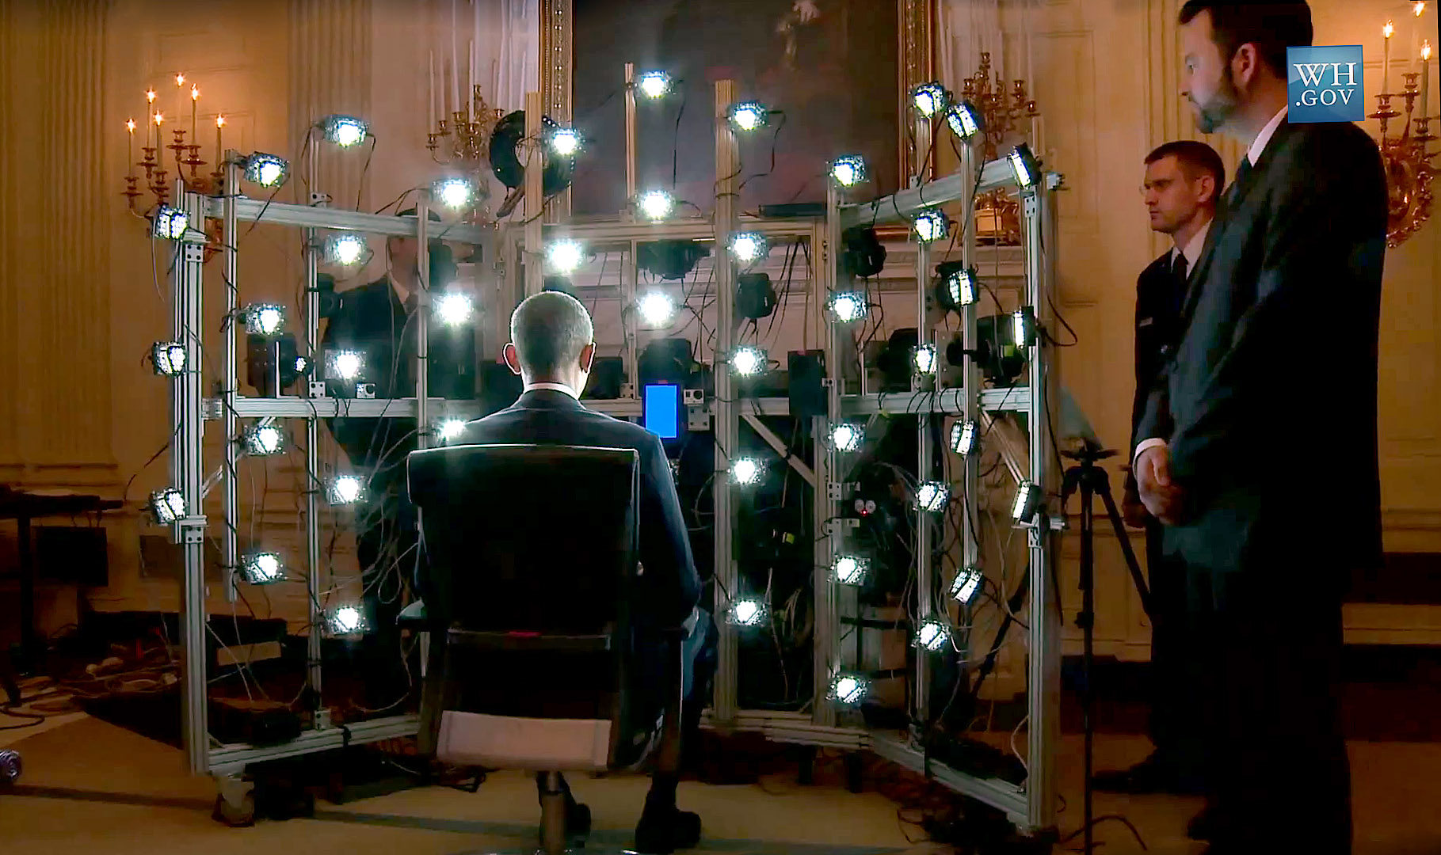
Human shape capture
Notes:
http://gl.ict.usc.edu/Research/presidentialportrait/

Slide 22
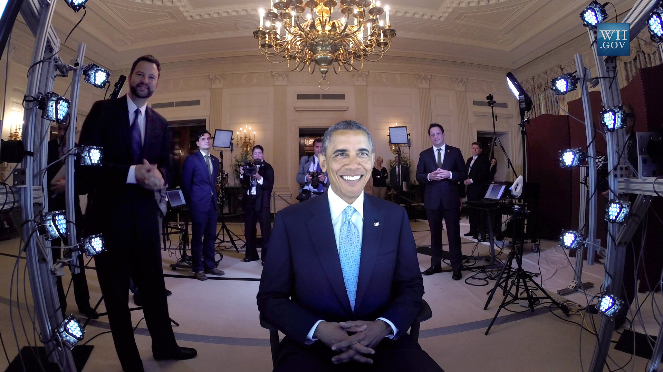
Human shape capture
Notes:
http://gl.ict.usc.edu/Research/presidentialportrait/

Slide 23
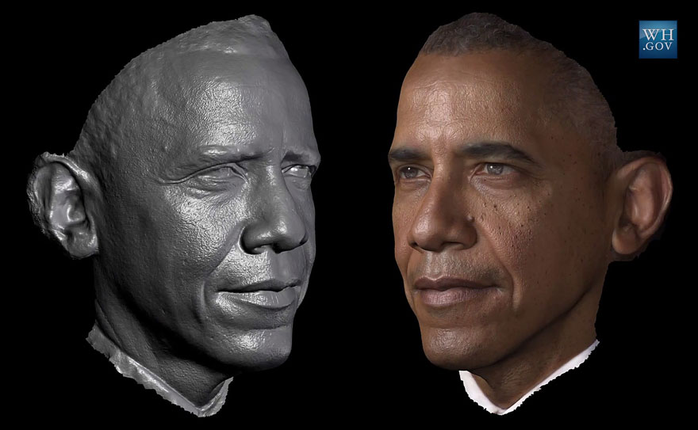
Human shape capture
Notes:
http://gl.ict.usc.edu/Research/presidentialportrait/

Slide 24
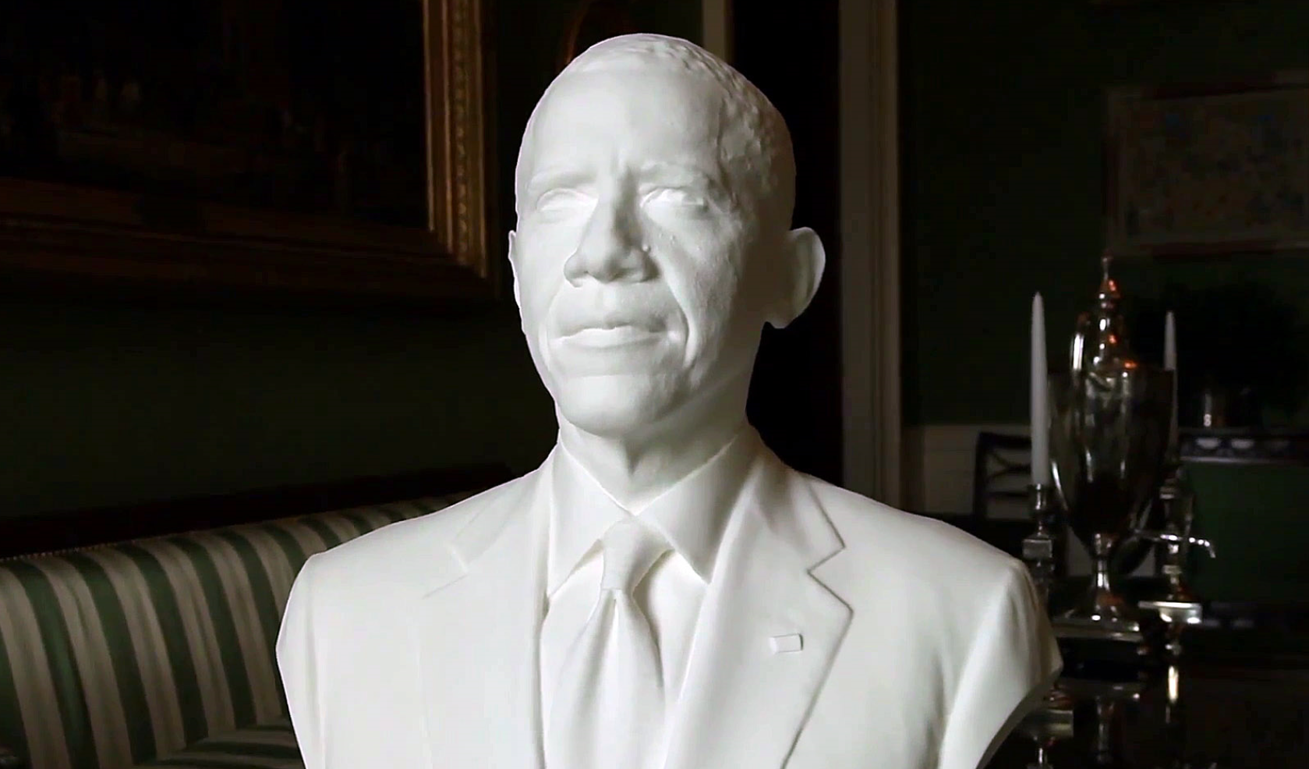
Human shape capture
Notes:
http://gl.ict.usc.edu/Research/presidentialportrait/

Slide 25
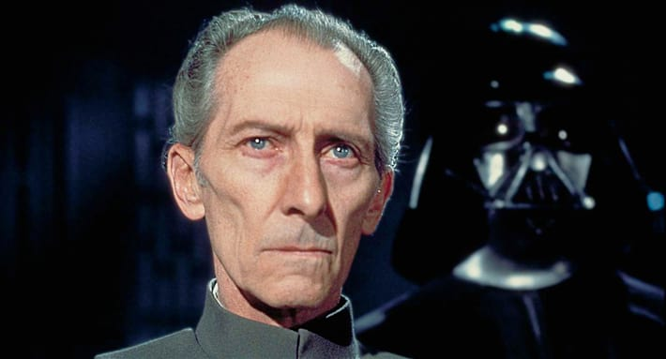
Special effects: shape capture
Star Wars: Rogue One – Peter Cushing / Admiral Tarkin

Slide 26
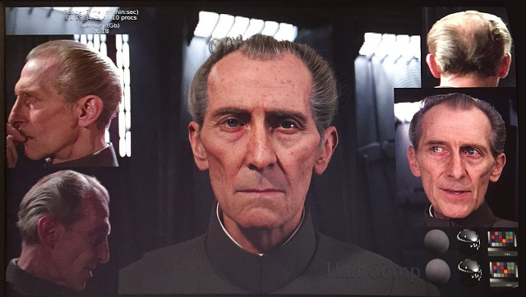
Special effects: shape capture
Notes:
http://cinetropolis.net/tarkin-care-of-business-rogue-ones-digital-peter-cushing/

Slide 27
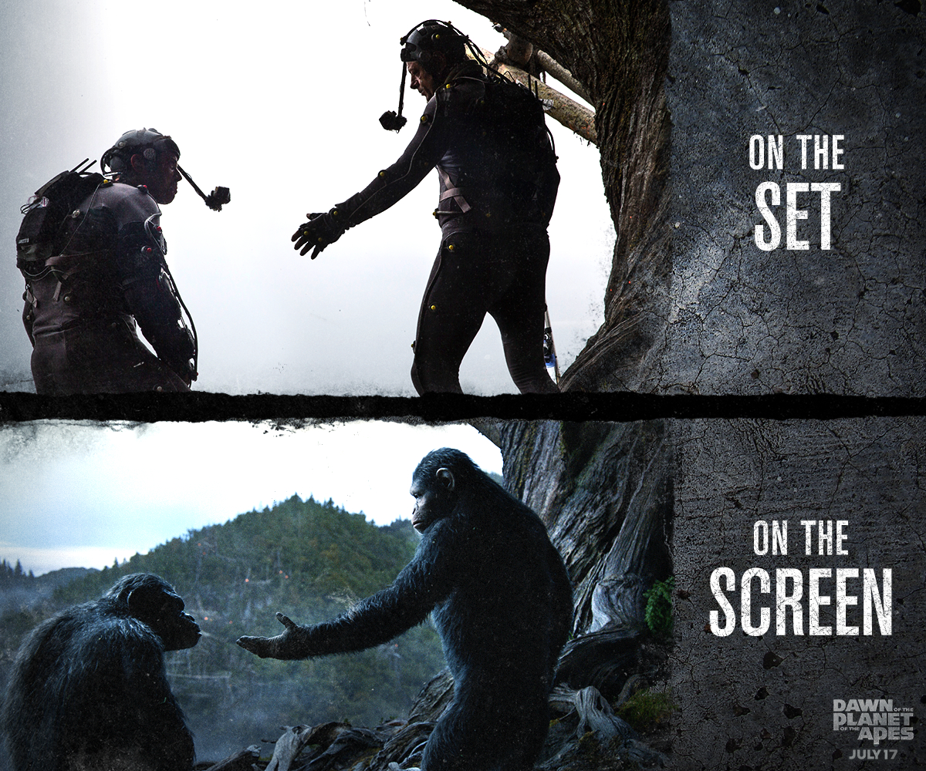
Special effects: motion capture
Notes:
http://www.digitalspy.com/movies/oscars/feature/a584704/why-andy-serkis-deserves-an-oscar-nomination-for-planet-of-the-apes/?zoomable
Weta

Slide 28
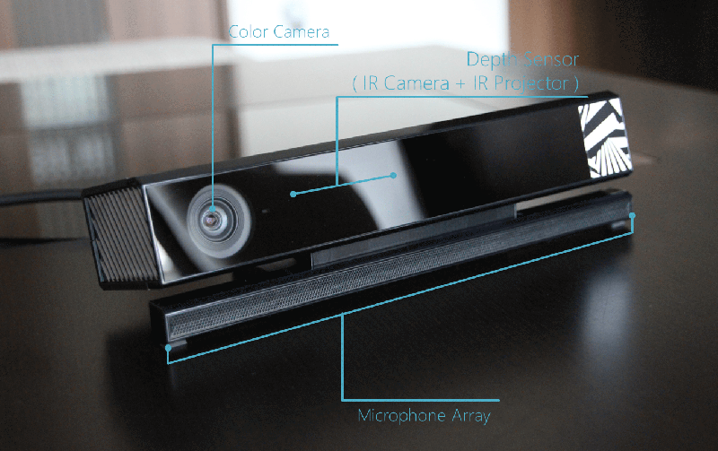
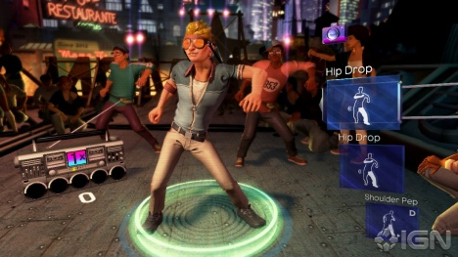
Interactive Games: Kinect
Object Recognition: http://www.youtube.com/watch?feature=iv&v=fQ59dXOo63o
Mario: http://www.youtube.com/watch?v=8CTJL5lUjHg
3D: http://www.youtube.com/watch?v=7QrnwoO1-8A
Robot: http://www.youtube.com/watch?v=w8BmgtMKFbY
JH

Slide 29
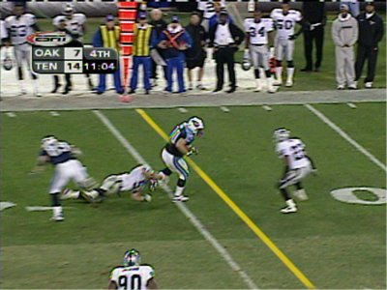
Sports
Sportvision first down line
Nice explanation on www.howstuffworks.com
http://www.sportvision.com/video.html
JH

Slide 30
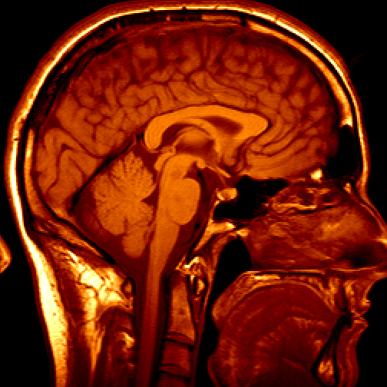
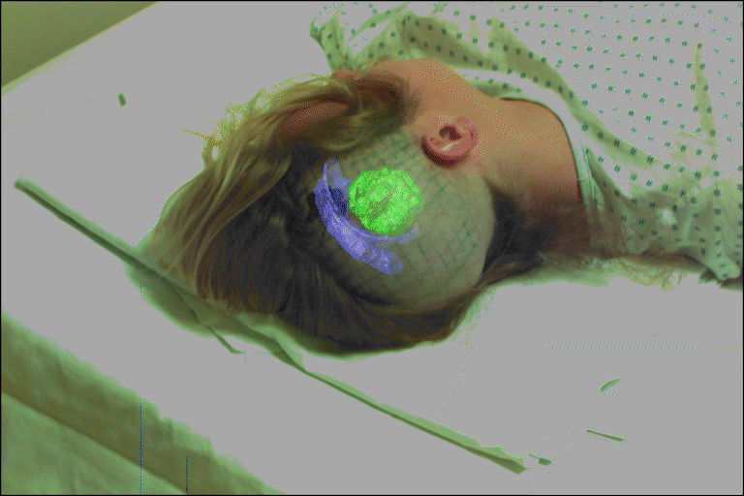
Medical imaging
3D imaging
MRI, CT
Image guided surgery
Grimson et al., MIT
JH

Slide 31
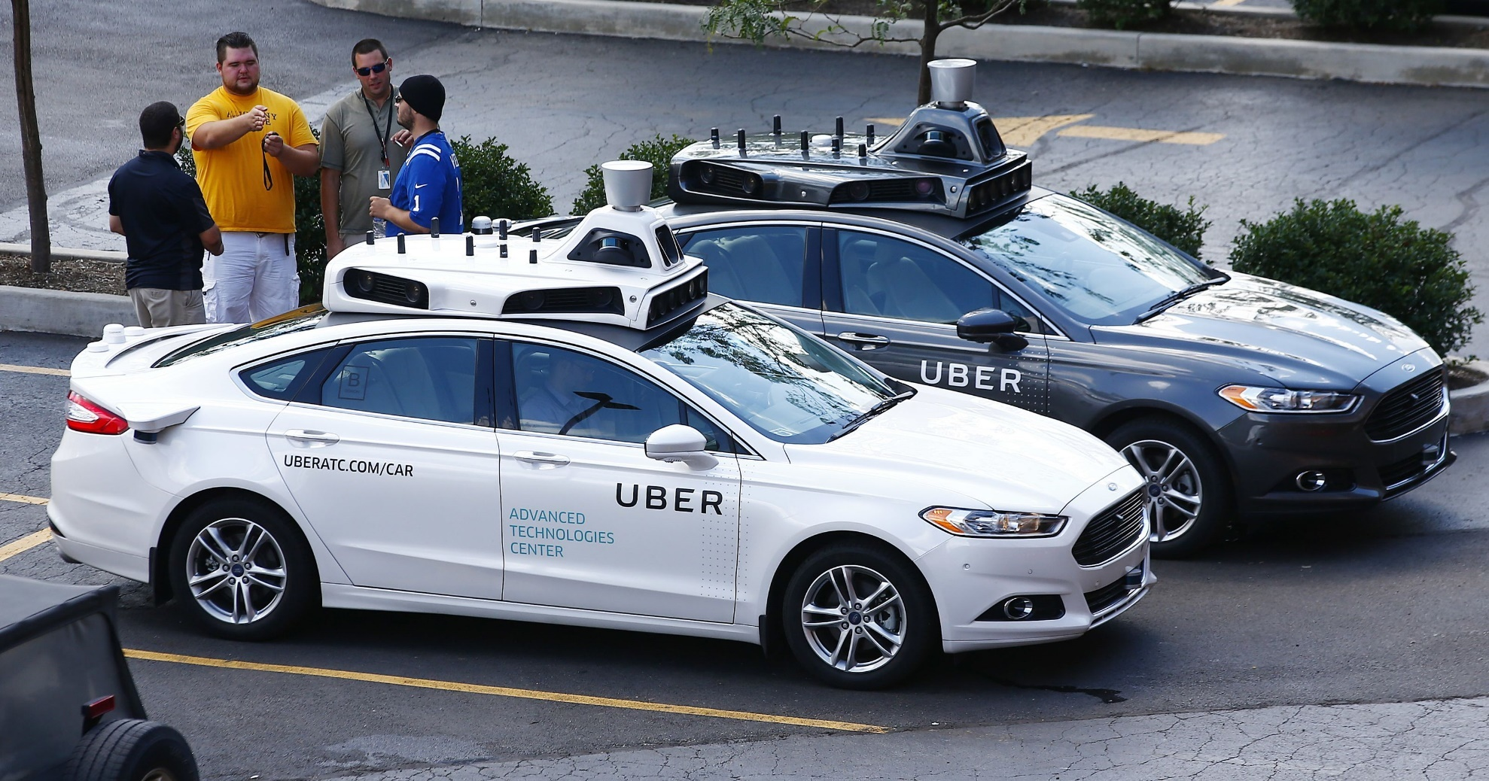
AutoCars - Uber bought CMU’s lab
Notes:
Ask class to count the number of cameras.
http://www.cmu.edu/news/stories/archives/2015/february/uber-partnership.html
http://www.wsj.com/articles/is-uber-a-friend-or-foe-of-carnegie-mellon-in-robotics-1433084582
http://www.freep.com/story/money/cars/ford/2016/08/21/uber--lyft-gm-pittsburgh-autonomous-vehicles-self-driving-autos-equal-profits/88944036/
Oct 9, 2010. "Google Cars Drive Themselves, in Traffic". The New York Times. John Markoff
June 24, 2011. "Nevada state law paves the way for driverless cars". Financial Post. Christine Dobby
Aug 9, 2011, "Human error blamed after Google's driverless car sparks five-vehicle crash". The Star (Toronto)

Slide 32
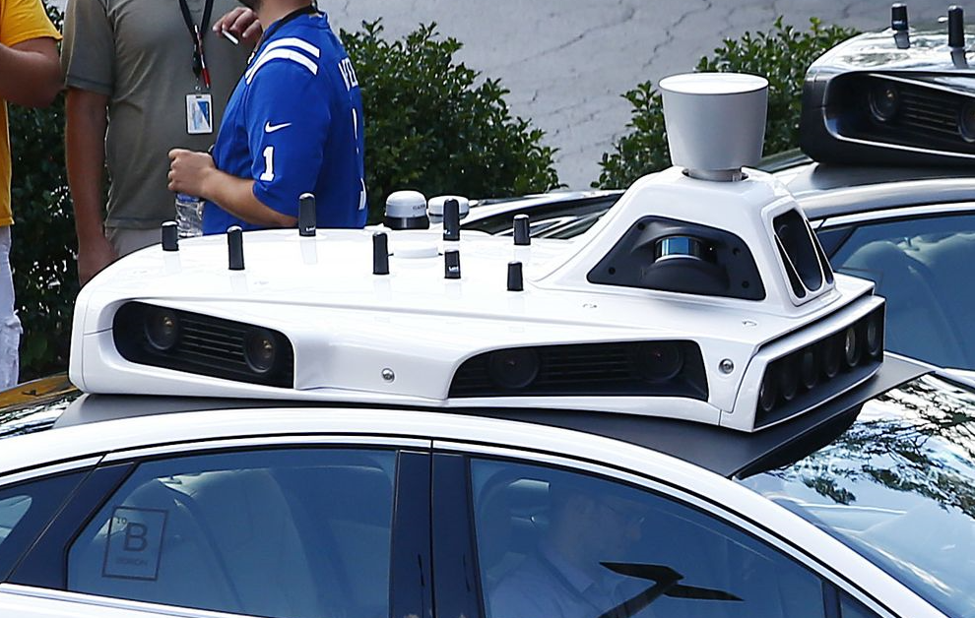
Notes:
Ask class to count the number of cameras.

Slide 33
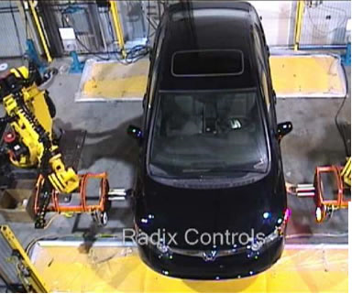
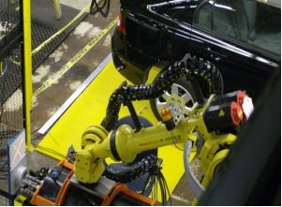
Industrial robots
Vision-guided robots position nut runners on wheels
JH

Slide 34
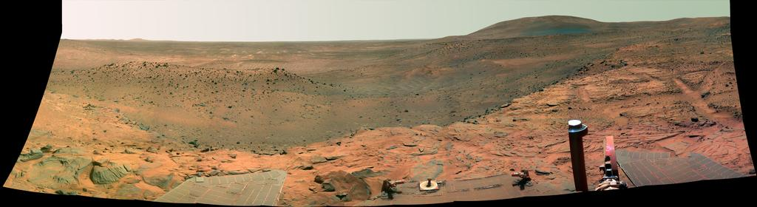
Vision in space
NASA'S Mars Exploration Rover Spirit captured this westward view from atop a low plateau where Spirit spent the closing months of 2007.
Vision systems (JPL) used for several tasks
Panorama stitching
3D terrain modeling
Obstacle detection, position tracking
For more, read “Computer Vision on Mars” by Matthies et al.
JH

Slide 35

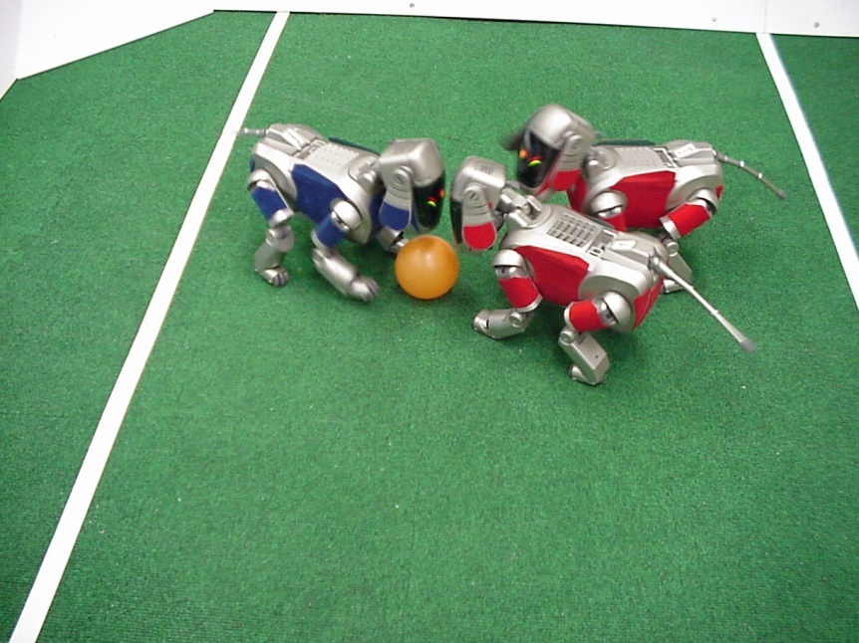
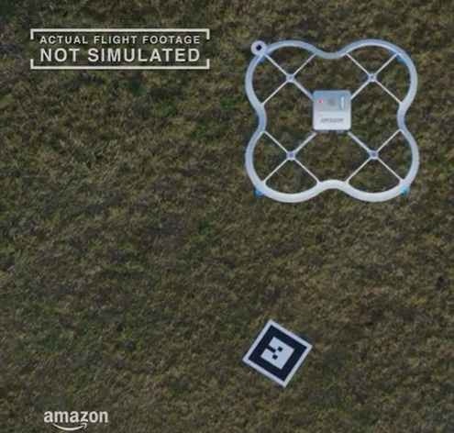
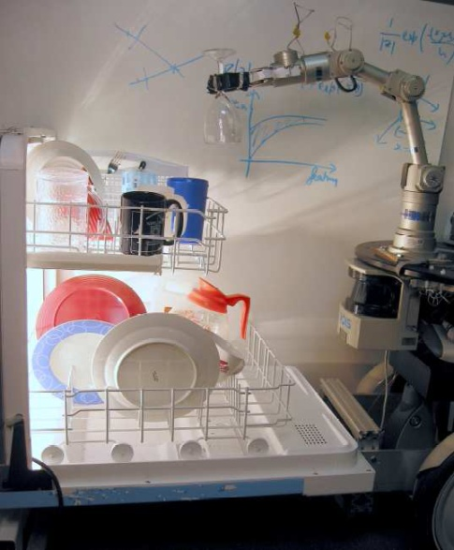

Mobile robots
NASA’s Mars Spirit Rover
http://en.wikipedia.org/wiki/Spirit_rover
http://www.robocup.org/
Saxena et al. 2008
STAIR at Stanford
JH
Notes:
DRONES!
https://www.skydio.com/

Slide 36
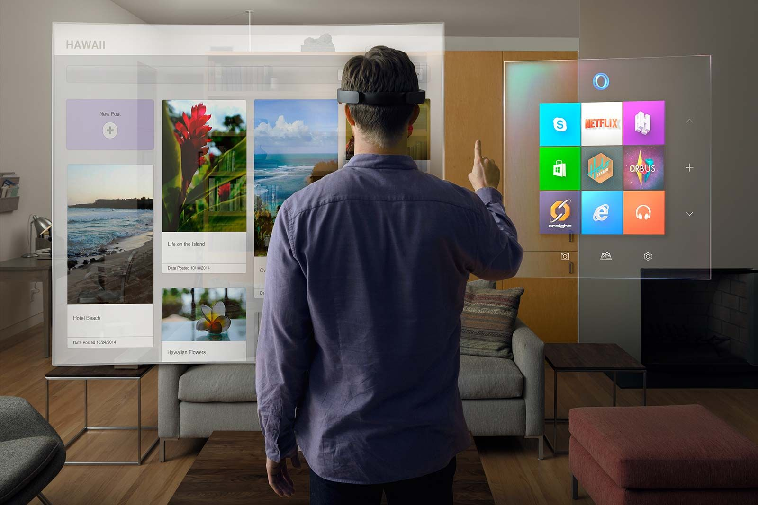
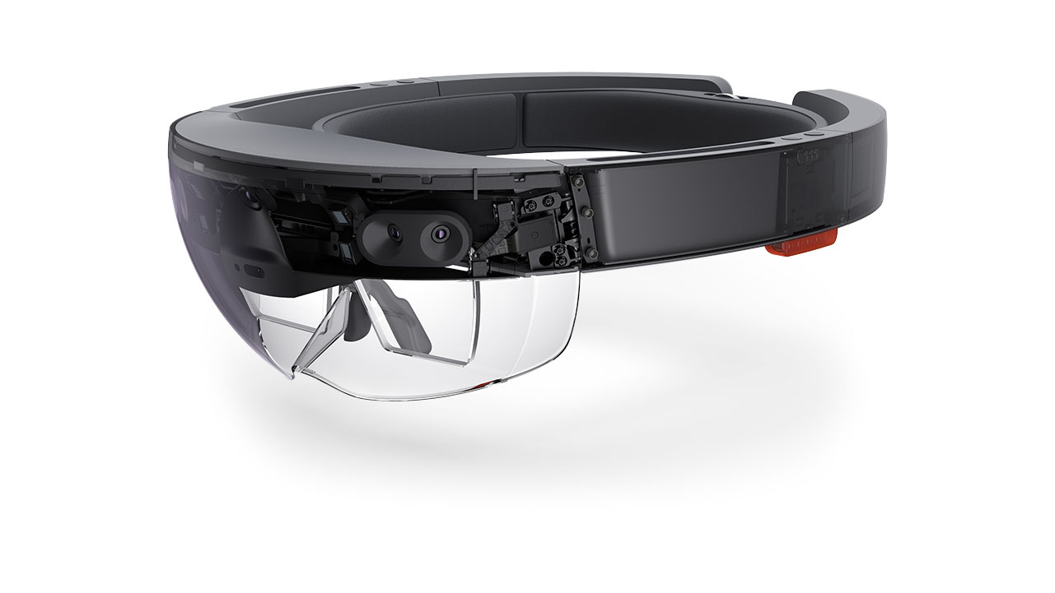
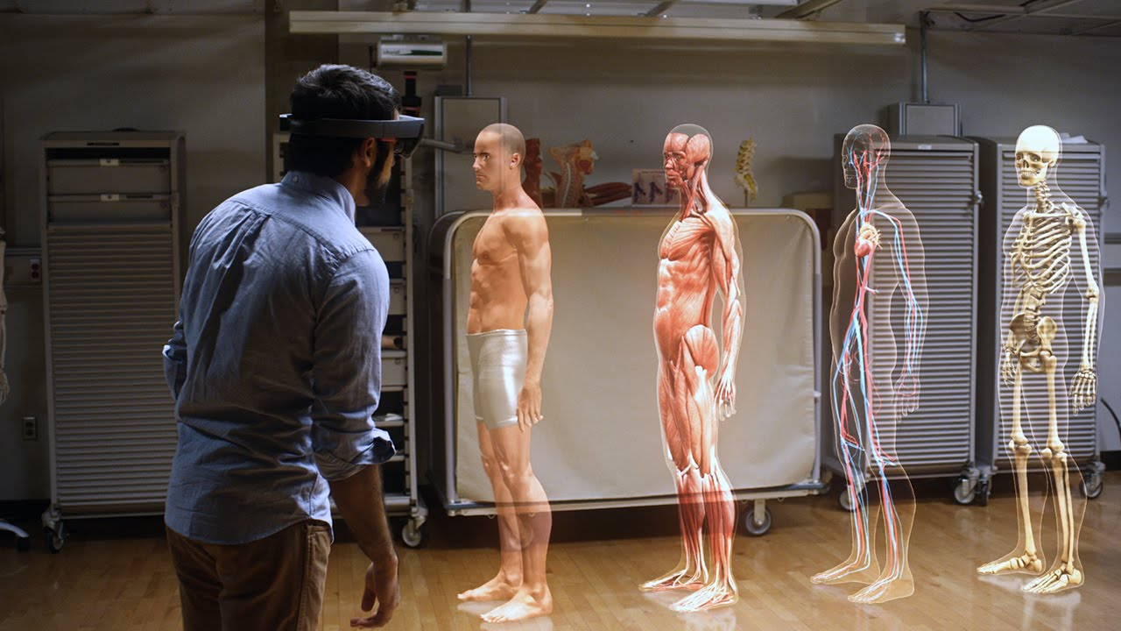
Augmented Reality and Virtual Reality
MS HoloLens, Oculus, Magic Leap,

Slide 37
Jitendra Malik, UC Berkeley
Three ‘R’s of Computer Vision
“[Further progress in] the classic problems of computational vision:
reconstruction
recognition
(re)organization
[requires us to study the interaction among these processes].”
Notes:
Jitendra Malik – pioneer of computer vision (?)
Tried to coin a ‘Three R’s’ for computer vision. Instead of ‘reading, writing, and arithmetic’….
“For example, in the recent PASCAL benchmark challenge on visual object detection, the average precision for most 3D object categories was under 50%.”

Slide 38
State of the art today?
With enough training data, computer vision nearly matches human vision at most recognition tasks
Deep learning has been an enormous disruption to the field. Many techniques are being “deepified”.
JH

Slide 39

Notes:
Wired in the UK – who is important?
We hear that deep learning is revolutionizing many aspects of computing, so there must be some people on here from deep learning…
<This whole Wired 100 section was James Hays’ idea; JT added Dennis Hassabis.>

Slide 40
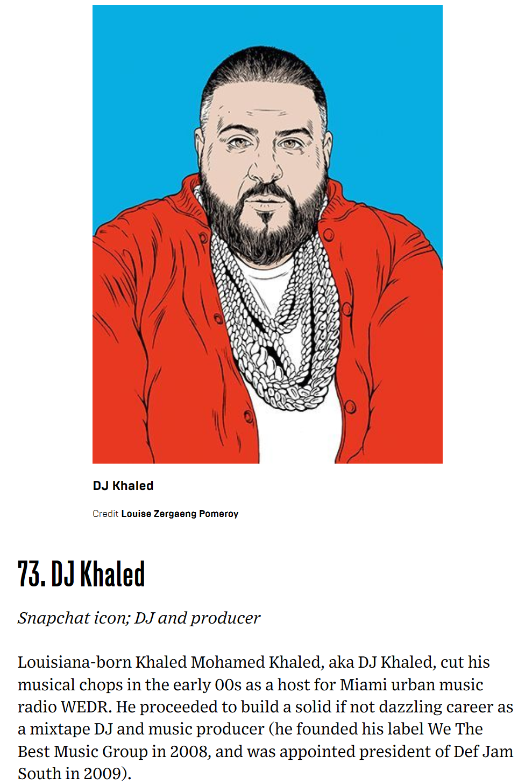
Notes:
In late 2015–16, a number of Snapchat videos of Khaled's detailing his "key to success" received significant attention on the internet due to his larger than life persona. This newfound online recognition caused him to gain popularity; becoming an "internet phenomenon", with some now describing him as a "living meme" or
"meme in human form".^{[56][57][58]}

Slide 41
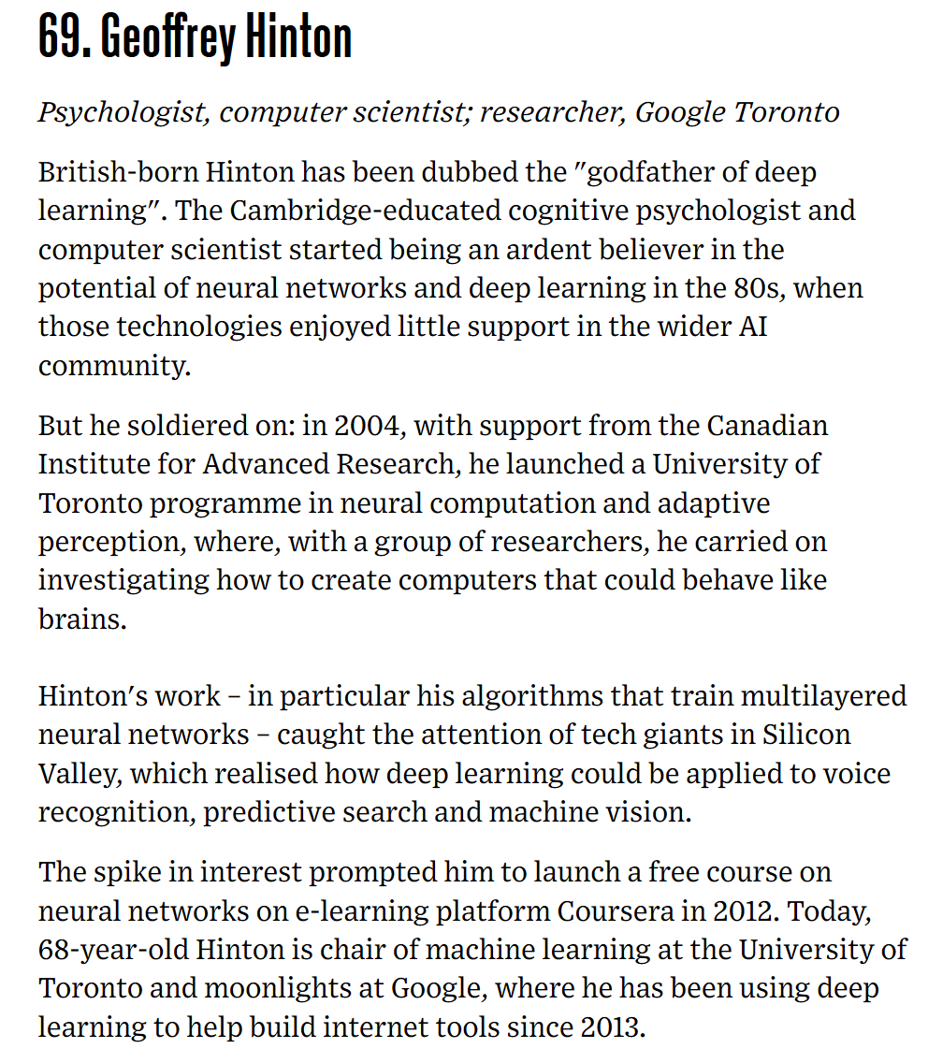

Slide 42
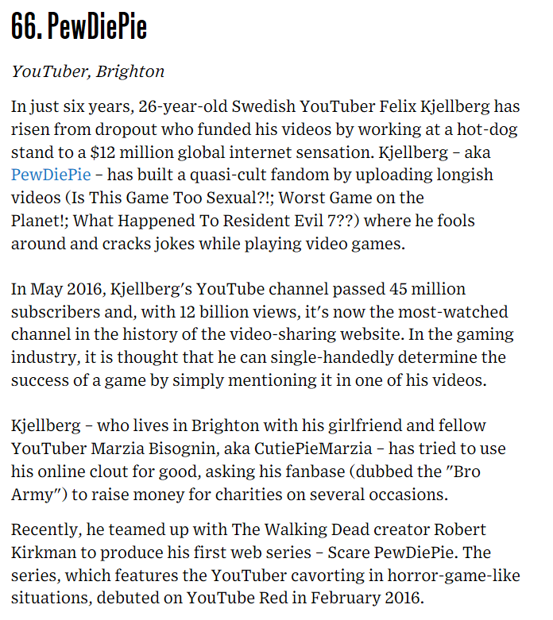

Slide 43
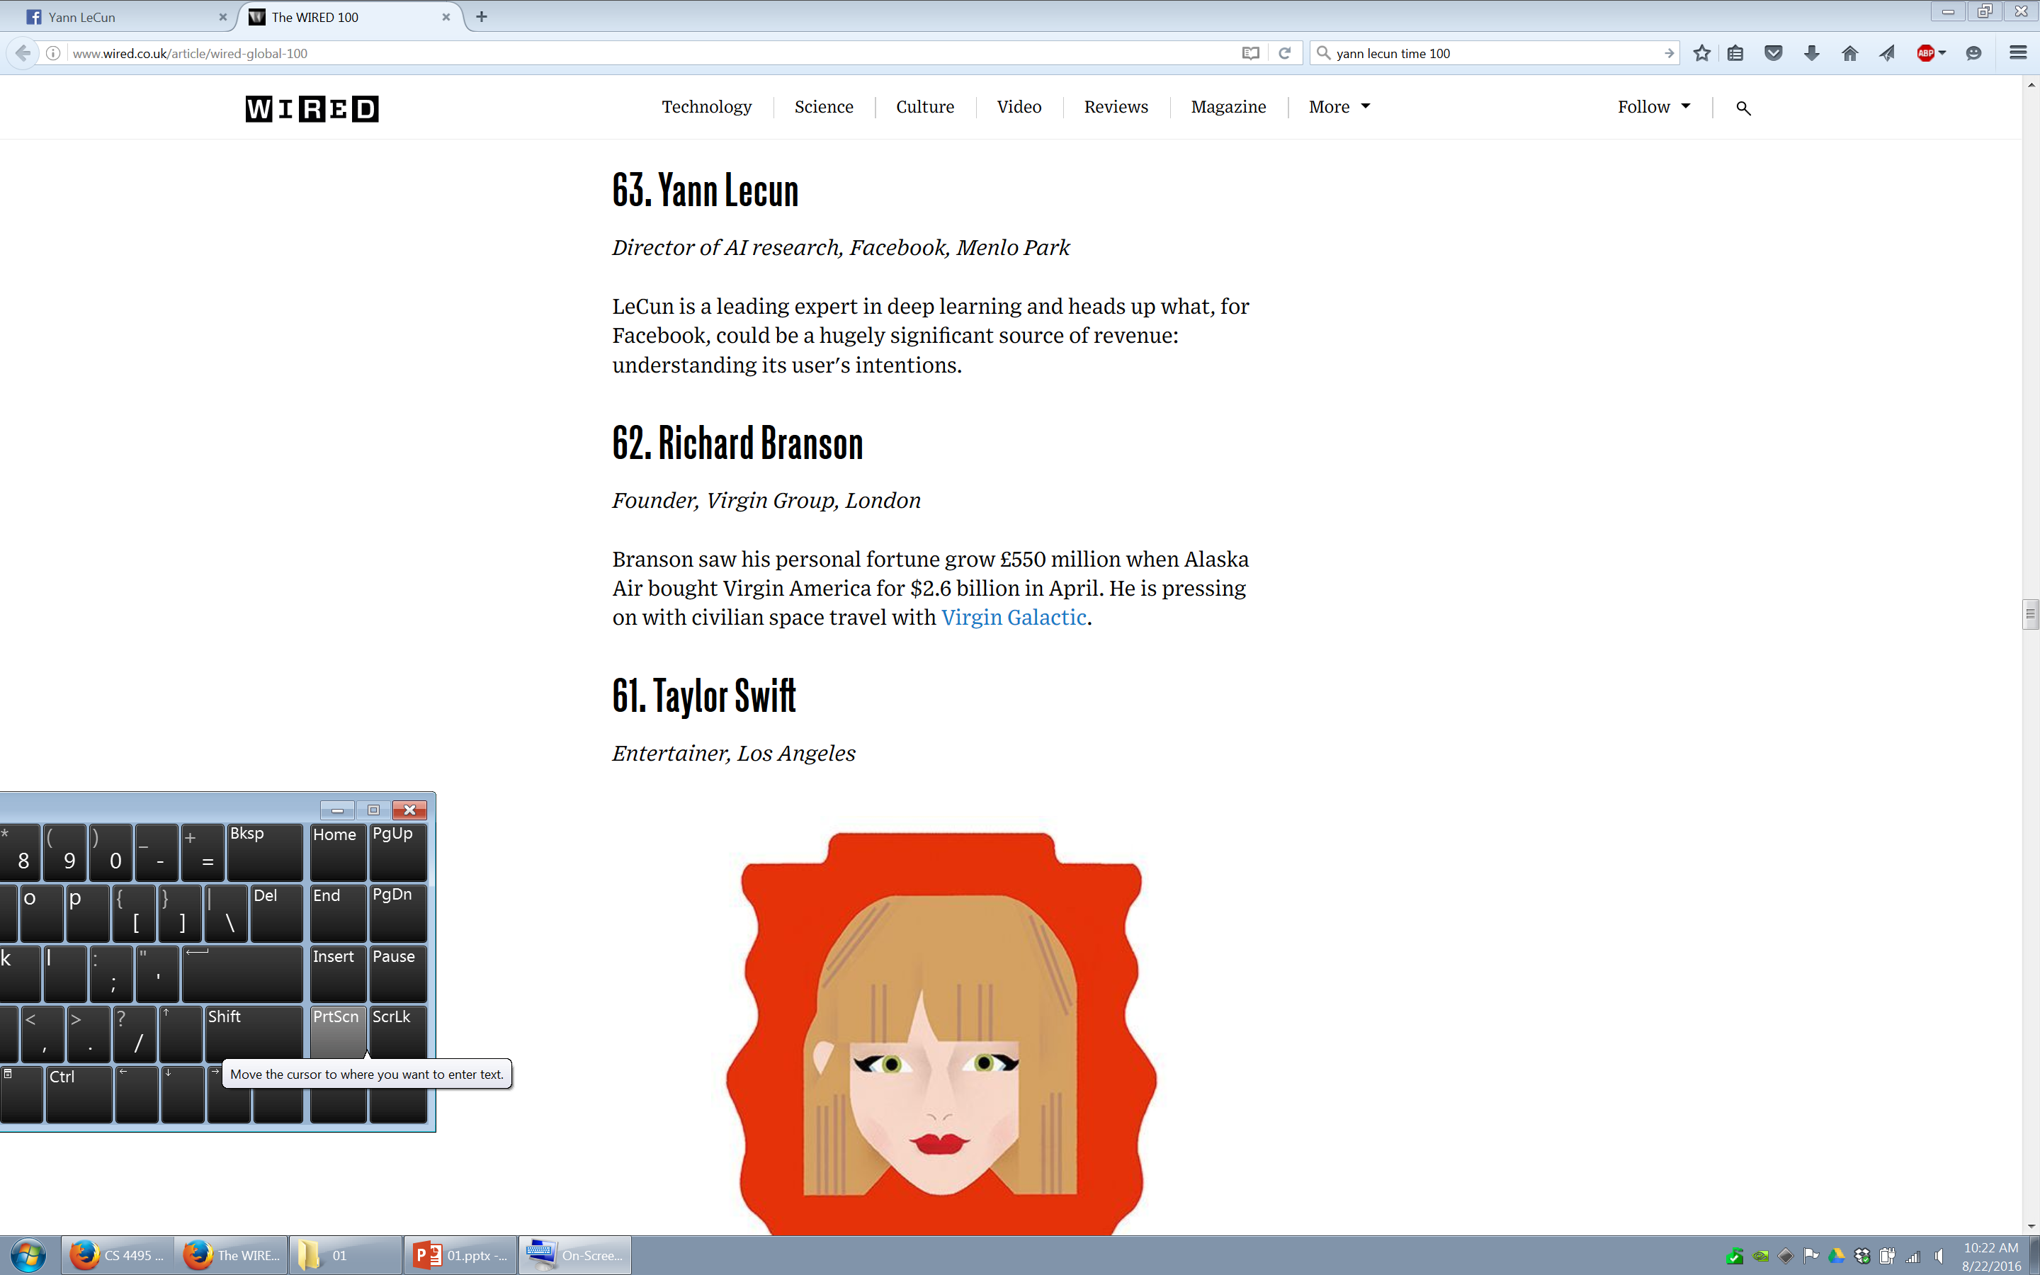

Slide 45
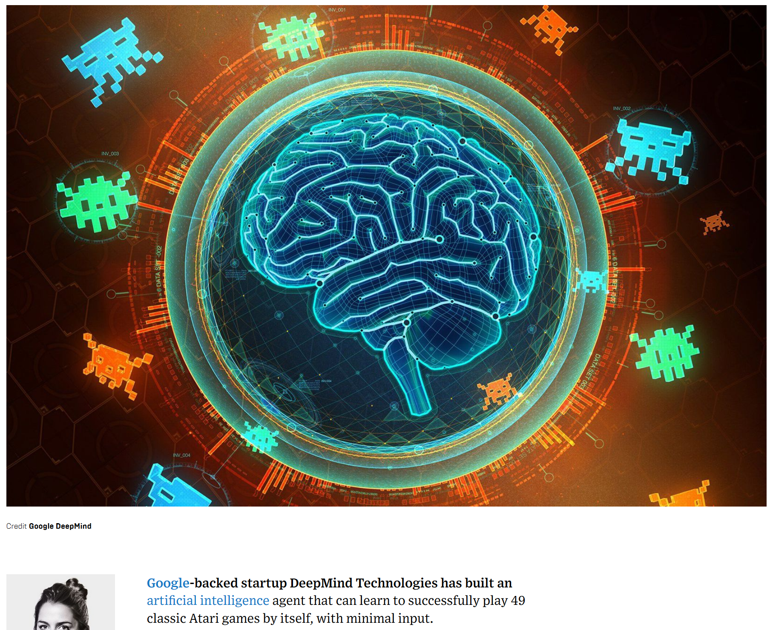

Slide 46
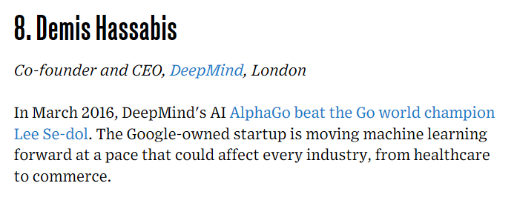

Slide 47
Computer Vision and Nearby Fields
Derogatory summary of computer vision:
“Machine learning applied to visual data.”
Computer Graphics: Models to Images
Computer Vision: Images to Models
JH

Slide 48
Scope of CSCI 1430
Computer Vision
Robotics
Machine Learning
Human Computer Interaction
Image Processing Geometric Reasoning Recognition Deep Learning
Graphics
Medical Imaging
Computational Photography
Neuroscience
Optics
JH

Slide 49
Course Staff

Slide 50
I work in here.
Interaction
Vision
Graphics
Notes:
I work in graphics, vision, and interaction. Generally, that means – if it takes input from a camera, and if the output is visual, then I’m probably interested. If it needs human interaction to achieve a result, or if it produces an interactive system at the end, then I’m probably interested.

Slide 51
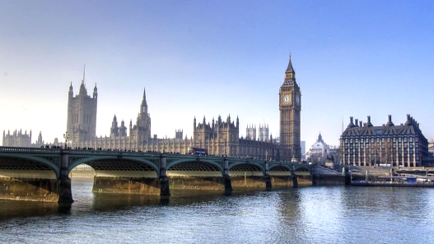
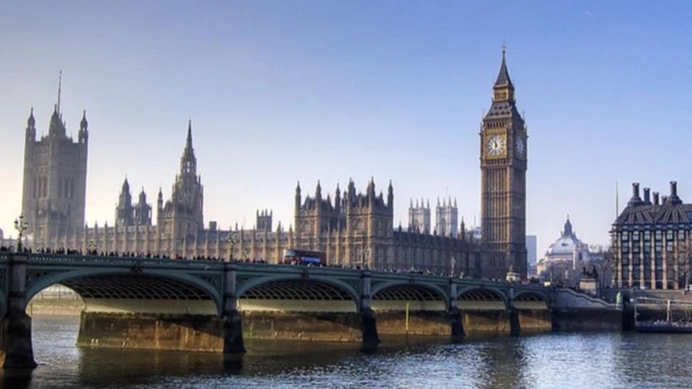
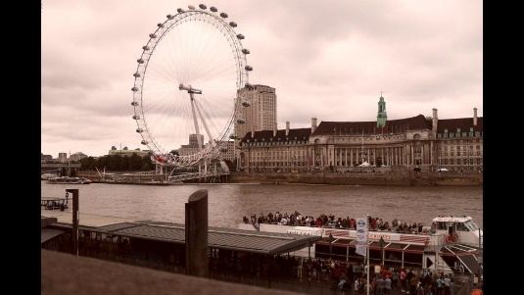
Start
End

Slide 52


Slide 53



Slide 54



Slide 55









Instructor: James Tompkin
Max Planck Institute
Germany
University College London
UK

Slide 56
Render pixels? Capture pixels? Interact with pixels?
I am probably interested.
Watch my research overview video!
james_tompkin@brown.edu
Office: CIT 547

Slide 57

TA introduction
Eric Xiao
Daniel Nurieli
Eleanor Tursman
Martin Zhu
Jackson (Jack) Gibbons

Slide 58

Ridiculously brief history of computer vision
1966: Minsky assigns computer vision as an undergrad summer project
1960’s: interpretation of synthetic worlds
1970’s: some progress on interpreting selected images
1980’s: ANNs come and go; shift toward geometry and increased mathematical rigor
1990’s: face recognition; statistical analysis in vogue
2000’s: broader recognition; large annotated datasets available; video processing starts
2010’s: Deep learning with ConvNets
2027: My very own robot? (Konidaris)
Guzman ‘68
Ohta Kanade ‘78
Turk and Pentland ‘91
JH

Slide 59
Course Topics
Interpreting Intensities
What determines the brightness and color of a pixel?
How can we use image filters to extract meaningful information from the image?
Correspondence and Alignment
How can we find corresponding points in objects or scenes?
How can we estimate the transformation between them?
Grouping and Segmentation
How can we group pixels into meaningful regions?
Categorization and Object Recognition
How can we represent images and categorize them?
How can we recognize categories of objects?
Advanced Topics
Action recognition, 3D scenes and context, human-in-the-loop vision…
JH

Slide 60
Class Intro
Freshman/Sophomores/Juniors/Seniors/Grads
Linear algebra
Probability?
Graphics course?
Vision/image processing course before?
Machine learning?

Slide 61
Prerequisites
CS 143 – James Hays
Continuing his course – many materials, the courseworks, from him + previous staff – serious thanks!
If you see ‘JH’ on a slide, then it is one of his.
Linear algebra, basic calculus, and probability
Programming, data structures

Slide 62
Contact
Course runs quiet hours – 9pm to 9am.
No contact! We will ignore you.
Piazza first
TAs are not on there all the time; set hours.
cs1430tas@lists.brown.edu second
TA office hours: Moon Lab 227, Tues-Thurs 7-9pm
James: Tues 1-2pm

Slide 63

Textbook
http://szeliski.org/Book/
JH

Slide 64


Textbook

Slide 65
Projects / Grading
100% programming projects (6 total)
Project 0 (do this immediately)
Install MATLAB
Go Help, go through ‘Getting Started with MATLAB’ tutorial. Familiarize.
Go through second tutorial (image operands)
Come to us in office hours (next week) if you have trouble.

Slide 66

Proj 1: Image Filtering and Hybrid Images
Implement image filtering to separate high and low frequencies.
Combine high frequencies and low frequencies from different images to create a scale-dependent image.
JH

Slide 67

Proj 2: Local Feature Matching
Implement interest point detector, SIFT-like local feature descriptor, and simple matching algorithm.
JH

Slide 68

Proj 3: Multi-view Geometry
Recover camera calibration from feature point matches.
Foundation for almost all measurement in computer vision.
JH

Slide 69

Proj 4: Scene Recognition with Bag of Words
Quantize local features into a “vocabulary”, describe images as histograms of “visual words”, train classifiers to recognize scenes based on these histograms.
JH

Slide 70

Proj 5: Object Detection with a Sliding Window
Train a face detector based on positive examples and “mined” hard negatives, detect faces at multiple scales and suppress duplicate detections.
JH

Slide 71

Proj 6: Convolutional Neural Net
Proj 4 again, but state of the art.
JH
Notes:
https://www.google.com/url?sa=i&rct=j&q=&esrc=s&source=images&cd=&cad=rja&uact=8&ved=0ahUKEwjWpuPJ3t3RAhXDQSYKHQ7BDNcQjRwIBw&url=https%3A%2F%2Fwww.youtube.com%2Fwatch%3Fv%3DbEUX_56Lojc&psig=AFQjCNE1JNwxCiwsH5qGq84B8O7xf7TOdQ&ust=1485448886394972

Slide 72
Any questions?!
Friday: Light and Color

